Slide 1

IronHack Data Analytics
WEEK 5 & 6 | Vanguard Group - A/B Test
Group 3 - Elohor, Mike, Angel, Prince

Slide 2

IRONHACK BOOTCAMP DA JAN 31
Agenda
Intro
Data Overview
Customer Demographics
Experiment & KPI’s
Major Obstacles & Lessons Learned
Exploratory Data Analysis
Conclusion and Insights

Slide 3
IRONHACK BOOTCAMP DA JAN 31
Introduction
Purpose: The aim of this project was to know if the Vanguard should invest in a new UI or not.
The conclusion was made by using A/B testing in order to determine the completion rates in both group for the current and new UI.

Slide 4

Main Question
Did the new UI lead to higher completion rates(> 5%)?

Slide 5



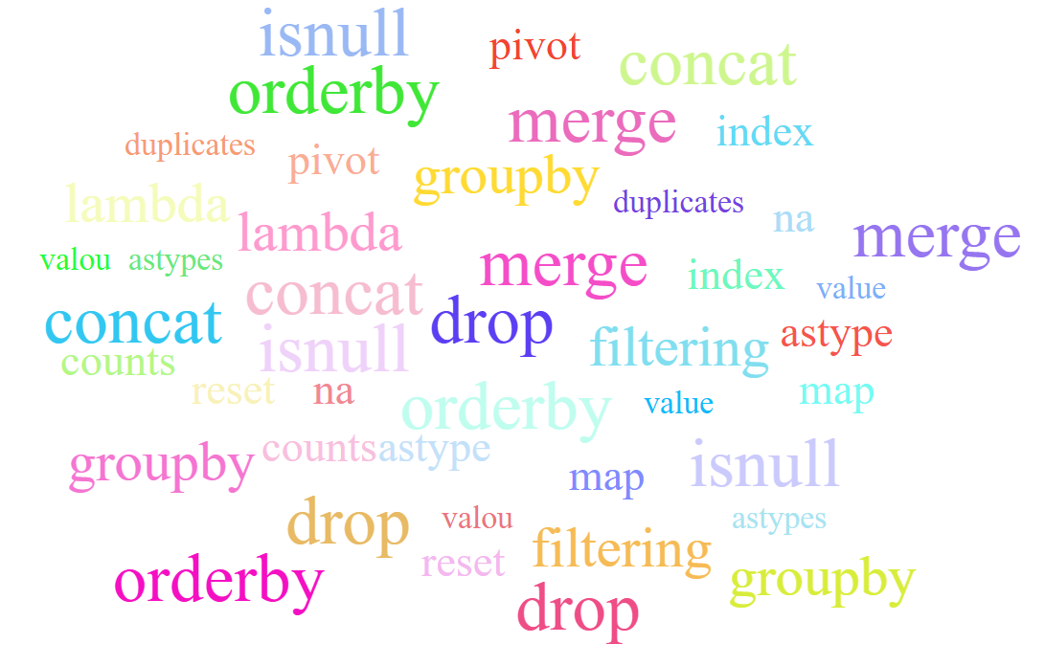


IRONHACK BOOTCAMP DA JAN 31
Data Overview
GROUPBY:
DATA SET
-Client Profiles
-Digital Footprints
-Experiment Roster
Age group:
<35 Young Age
<60 Middle Age
>60 Elder
Tenure group
10< Recent
15<Mid
25<Long
25>Lifelong
Step_jump:
“Step you left - Step you go to”

Slide 6
Exploratory Data Analysis

Slide 7
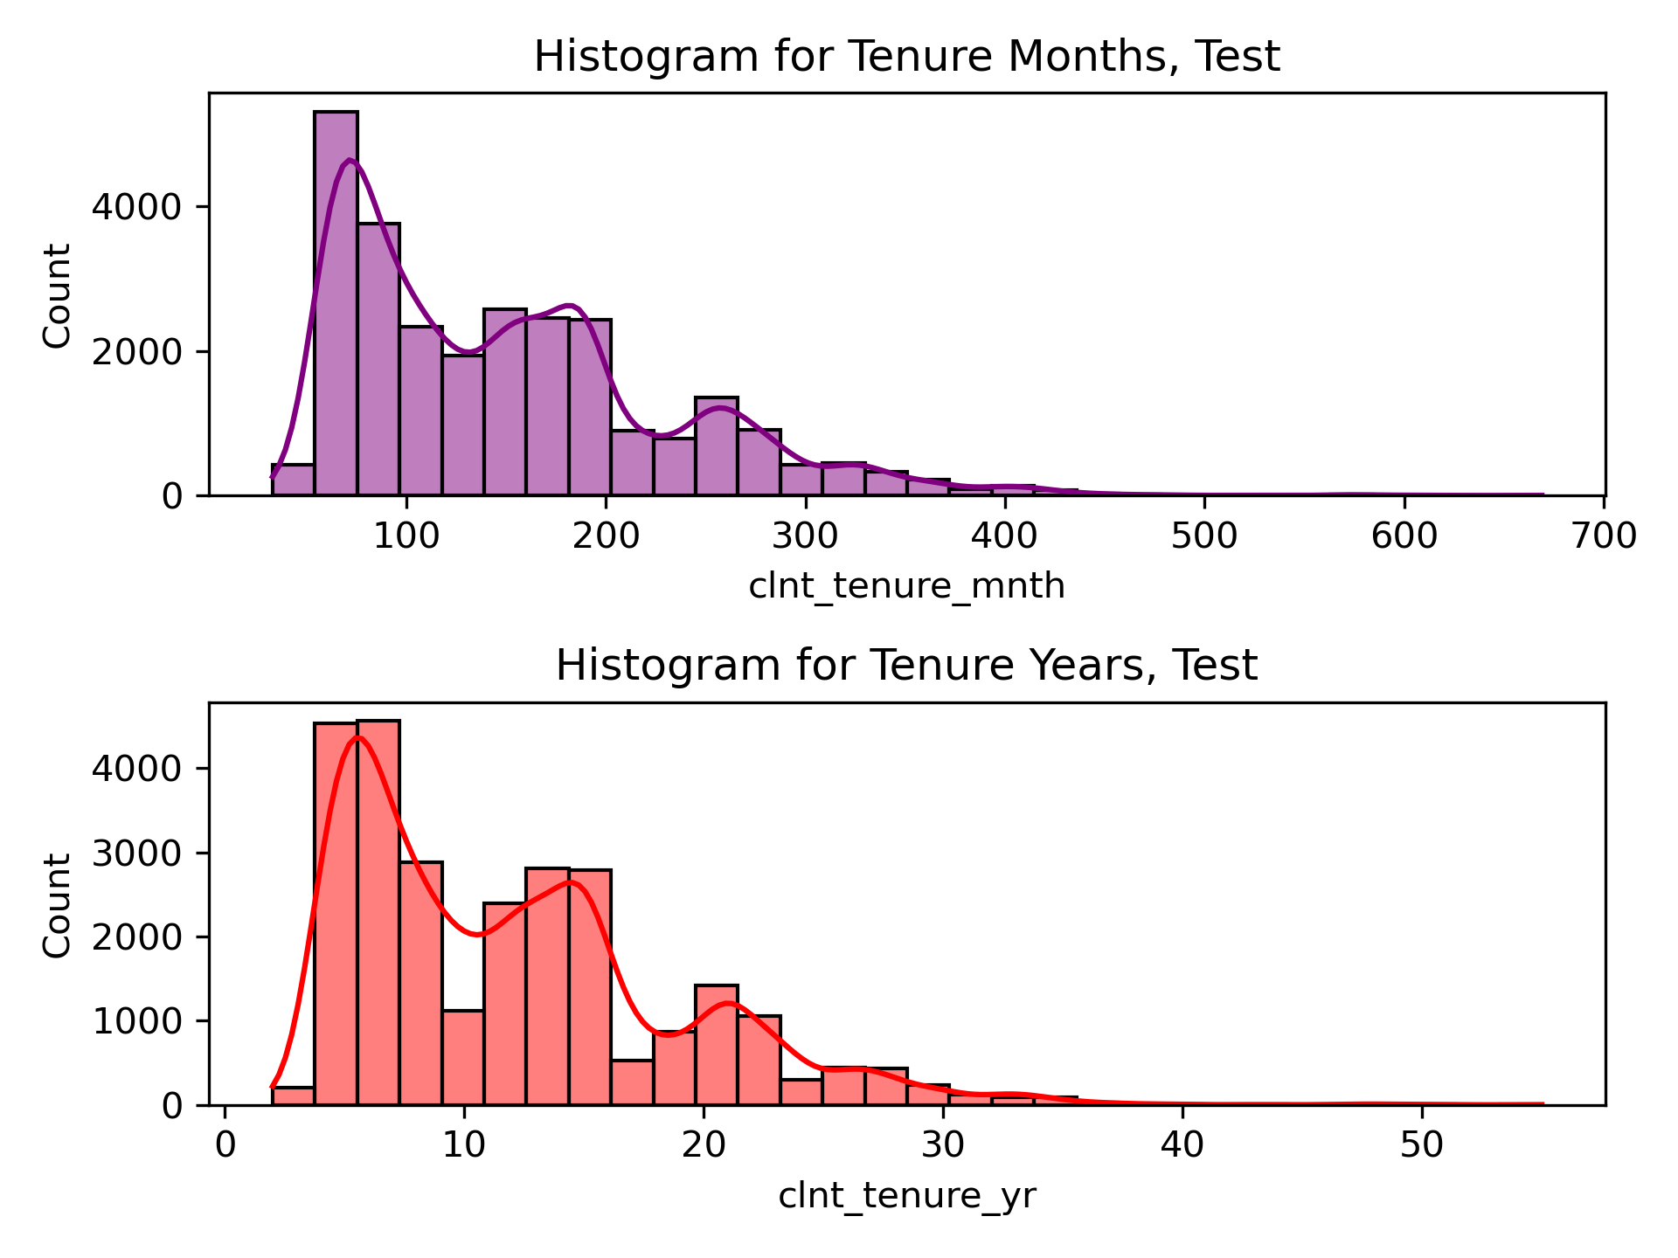
IRONHACK BOOTCAMP DA JAN 31
75% of Vanguard's account holders in this control group are long-term (6+ years), with 25% of clients holding accounts for 16+ years.

Slide 8
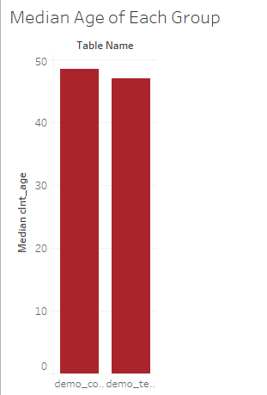
The median age for the control group is 48 while for the test group is 47.

Slide 9
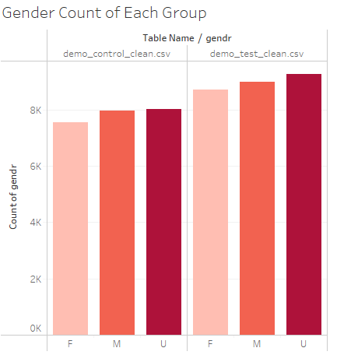
There is an even distribution of genders across both groups. Although, the test group has higher number of all genders.

Slide 10
IRONHACK BOOTCAMP DA JAN 31
Experiment Design Evaluation

Slide 11
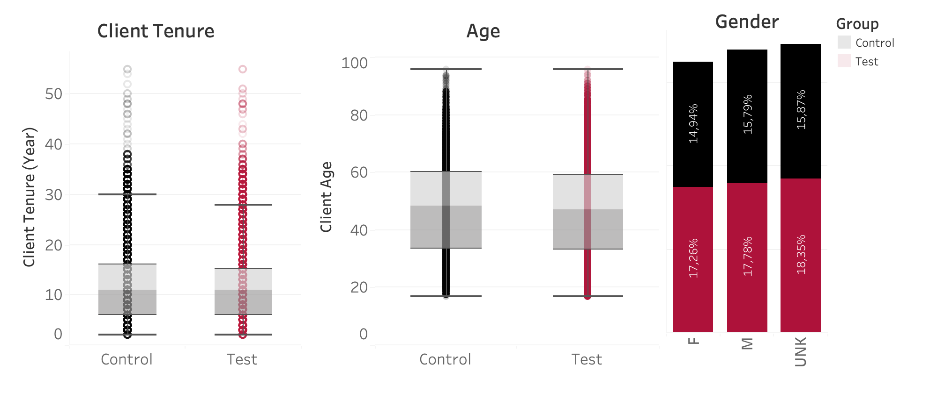
IRONHACK BOOTCAMP DA JAN 31
Were the test and control groups comparable? ✅
Notes:
Balanced Groups
Test & control groups were nearly identical in age, tenure, and gender.
Similar group sizes ensured fair comparison.

Slide 12

IRONHACK BOOTCAMP DA JAN 31
Could the experiment duration impact results?
Test duration: ~3 months
Visits: ~140,000 (control group) | ~180,000 (test group)
However…
Avg client age: ~55 years old
Avg. tenure: ~10 years
Notes:
Median client age is around 55 years old, and with the company 10+ years. Maybe a longer test would reveal even stronger results for the test group.
Potential Improvement
Extending the test duration could allow users to better adapt to the new design.
More time may provide clearer behavioral trends and long-term impact insights.
Key Takeaway
Strong initial setup, but a longer test period could enhance validity.

Slide 13
IRONHACK BOOTCAMP DA JAN 31
What are the key metrics for a successful test?

Slide 14
IRONHACK BOOTCAMP DA JAN 31
Performance Metrics 🏁🏎️
📊 Completion Rate % of users reaching the final "Confirm" step
⏳ Process Completion Time Avg. time to complete the process
⚠️ Error Rate % of steps where users moved backward
Notes:
1. Completion Rate Percentage of users reaching the final "Confirm" step. Evaluates funnel efficiency & drop-off points. Type: Numerical (Discrete)
2. Process Completion Time Average time taken to complete the online process. Helps optimize user experience & reduce friction. Type: Numerical (Continuous)
3. Error Rate Proportion of steps where users moved backward. Identifies pain points & usability issues. Type: Categorical (Discrete)

Slide 15
IRONHACK BOOTCAMP DA JAN 31
How much time does it take to log in?

Slide 16

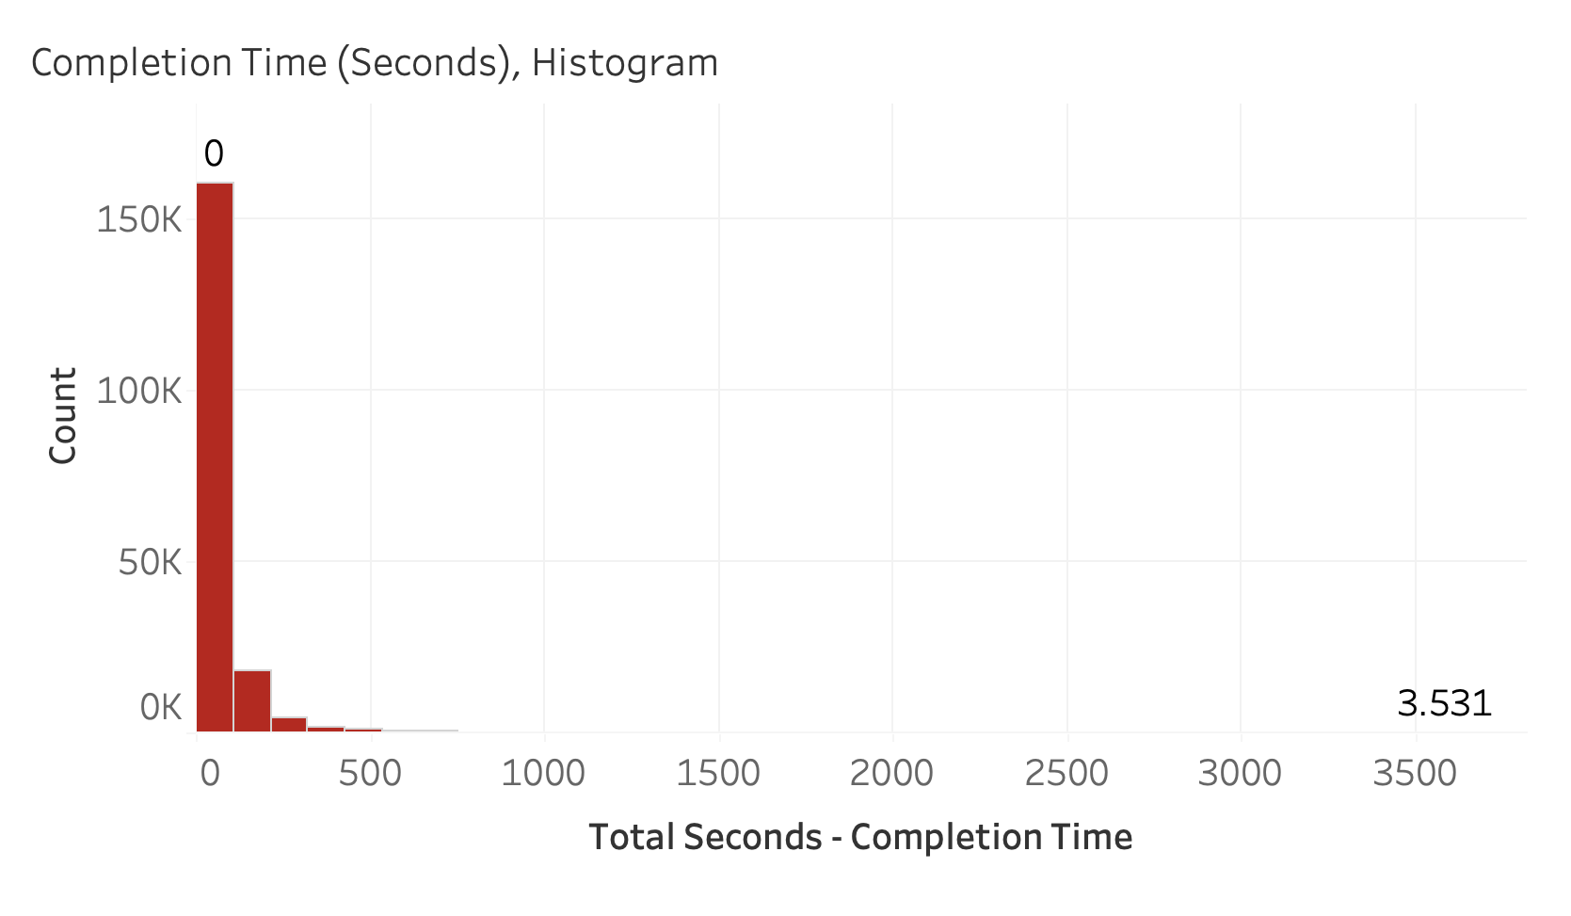
IRONHACK BOOTCAMP DA JAN 31
Log-in times Distribution
Transform with Log!
Notes:
Our data included some outliers where a few clients spent much longer than others to sign in

Slide 17
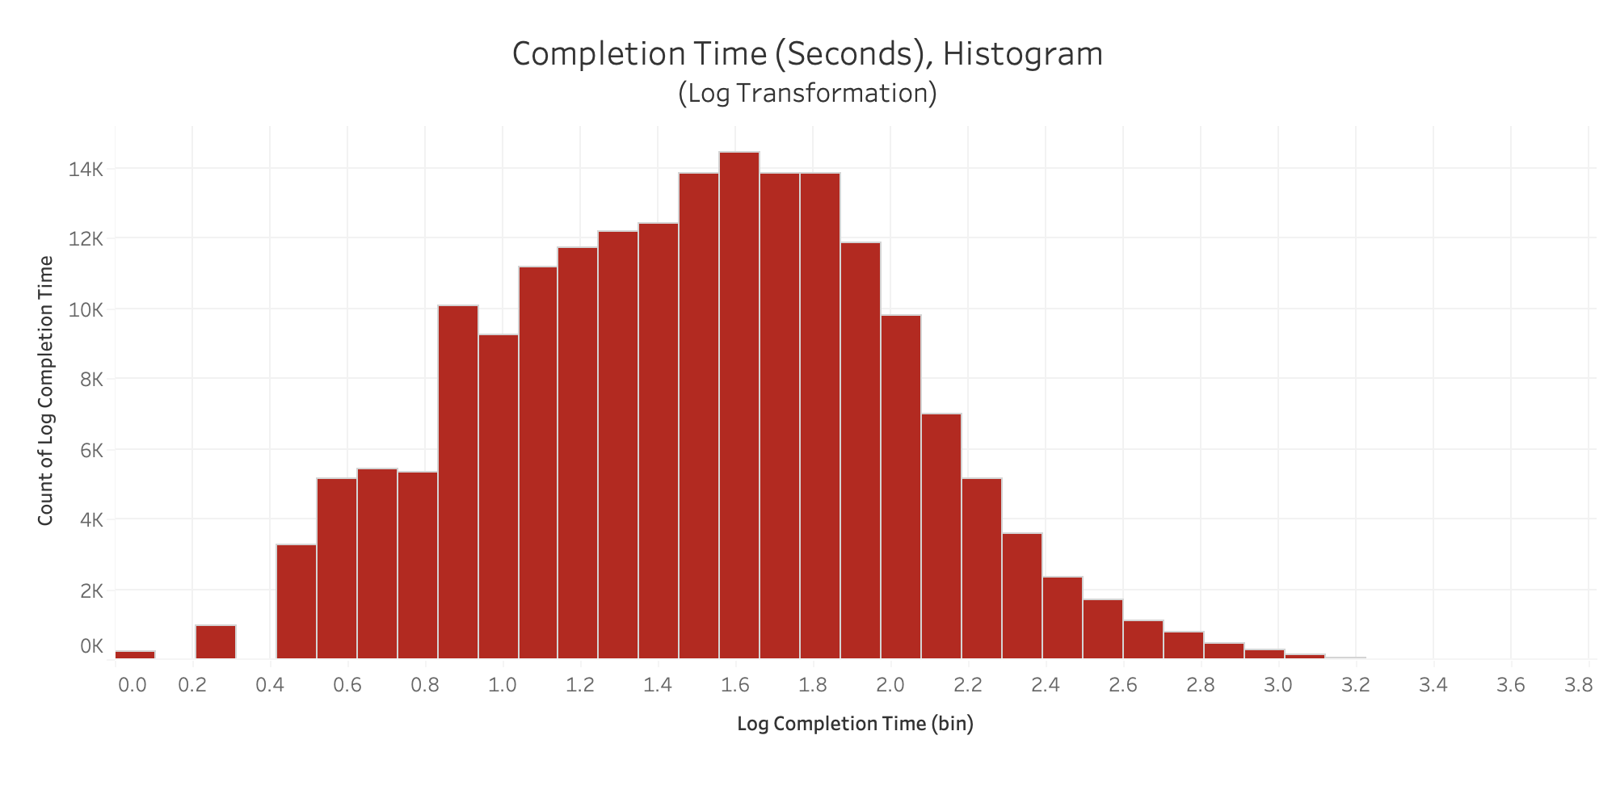
IRONHACK BOOTCAMP DA JAN 31
After log transformation
Notes:
Our data included some outliers where a few clients spent much longer than others to sign in

Slide 18
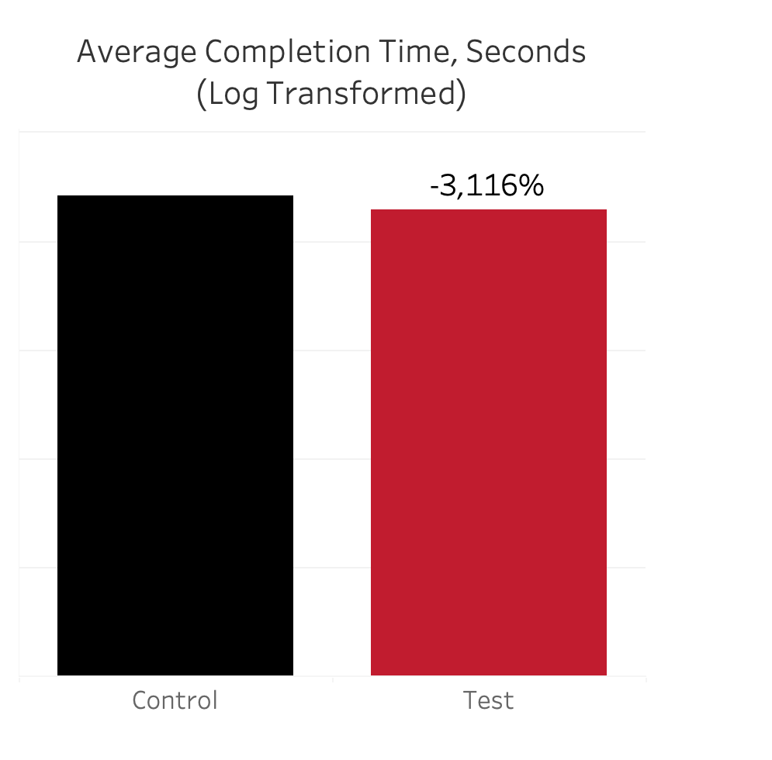
IRONHACK BOOTCAMP DA JAN 31
Which group had a faster avg. log-in time?
🏆
✅ Hypothesis: Test < Control (Completion Time) 📈 Decrease: 6.3 seconds 📊 Stats: Z = -21.61, P < 0.0001 🔎 Takeaway: Test group outperformed control
64.98
58.68
Notes:
Our data included some outliers where a few clients spent much longer than others to sign in

Slide 19
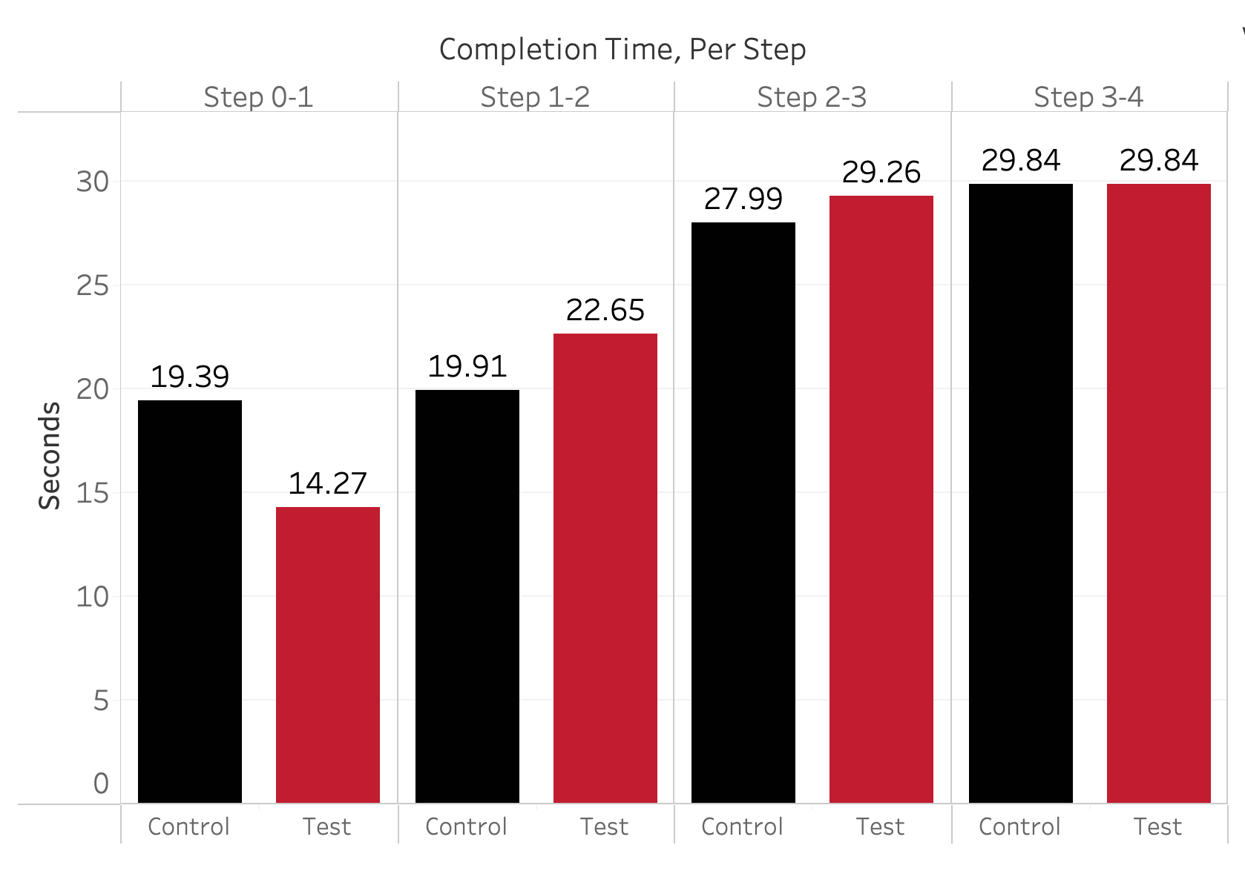
IRONHACK BOOTCAMP DA JAN 31
What steps take the most time?
Notes:
We see here that the test group performed the control group mainly in the first step of the log-in process.
Recommendations - Consider overhauling the first step to minimize disruptions and developer resources.

Slide 20
IRONHACK BOOTCAMP DA JAN 31
How many errors are made?

Slide 21
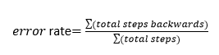

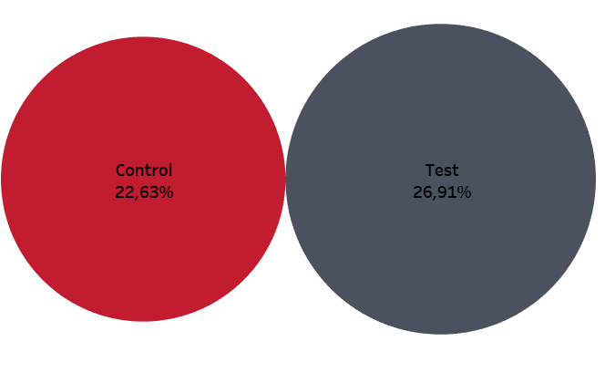
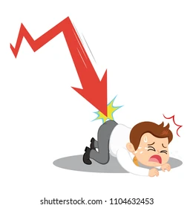
IRONHACK BOOTCAMP DA JAN 31
What is the overall error rate?
Hypothesis: Test <Control (Error Rate) 📈 Increase: +4.28% 📊 Stats: Z = 27,60, P > 0.9999 🔎 Takeaway: Control group outperformed test
Control
22,63%
Test
26,91%

Slide 22
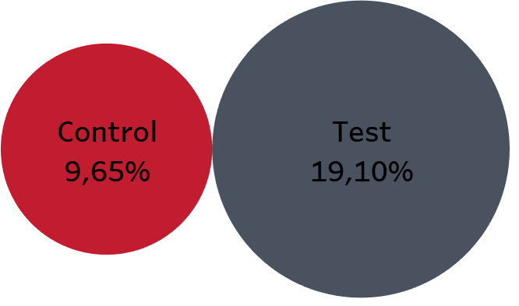
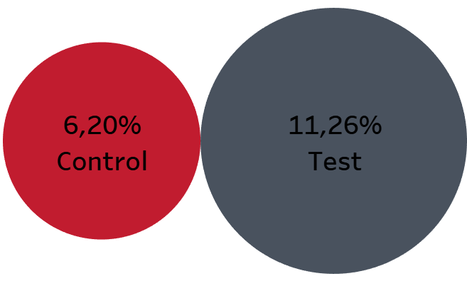

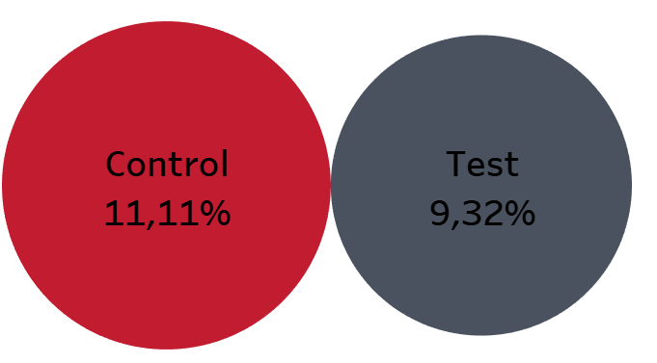
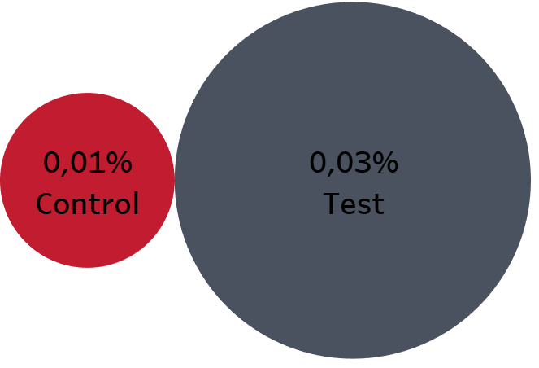
IRONHACK BOOTCAMP DA JAN 31
What step causes the most errors?
Step 1-0
Step 2-1
Control
9,65%
Test
19,10%
Test
11,26%
Control
6,20%
Step 3-2
Step 4-3
Control
11,11%
Test
9,32%
Control
0,01%
Test
0,03%

Slide 23
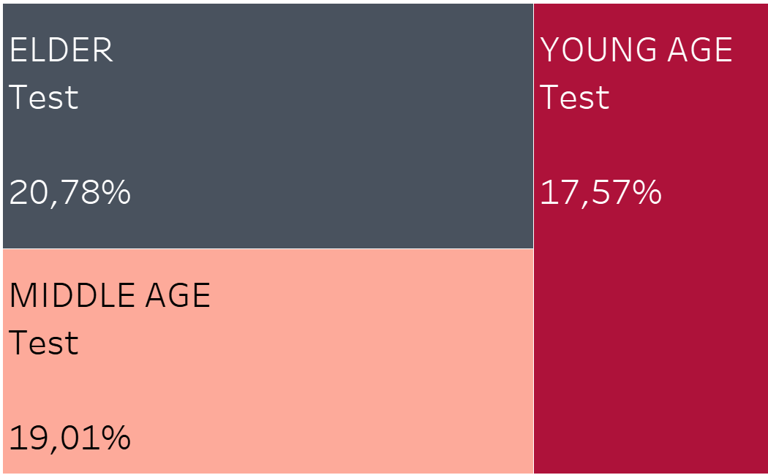




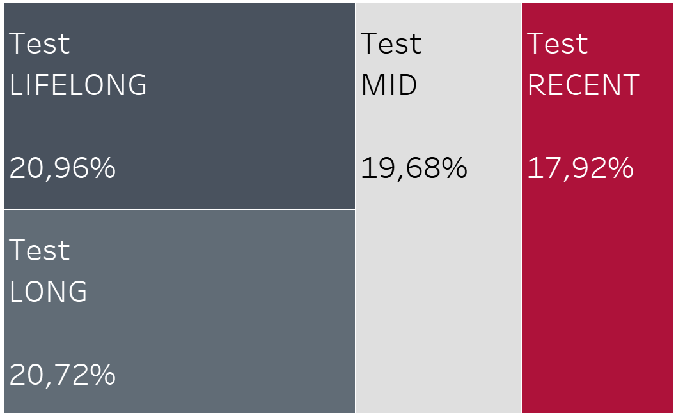
IRONHACK BOOTCAMP DA JAN 31
What step causes the most errors?
What is the origin?
1.
2.

Slide 24
IRONHACK BOOTCAMP DA JAN 31
What proportion of clients complete a log-in?

Slide 25
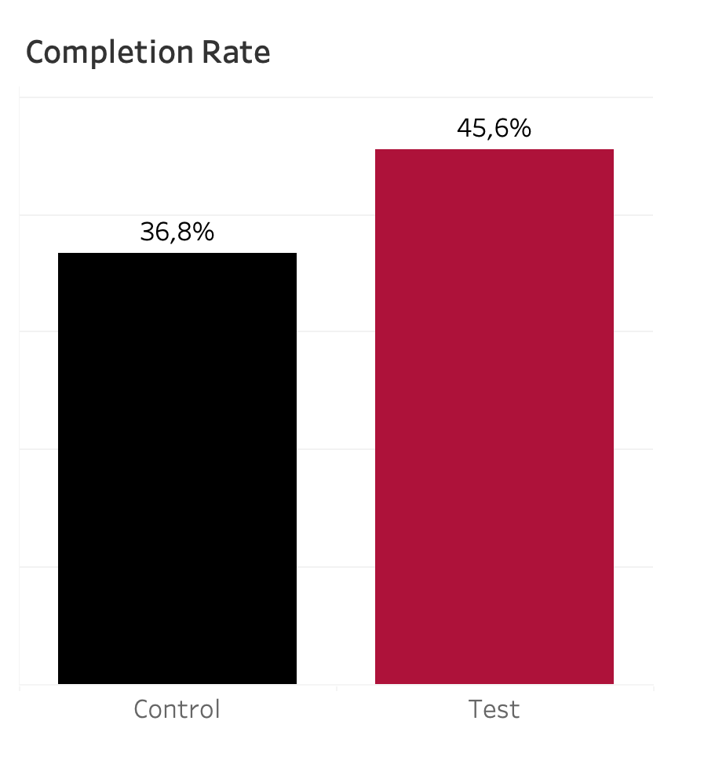
IRONHACK BOOTCAMP DA JAN 31
What’s the overall completion rate?
🏆
✅ Hypothesis: Test > Control (Completion Rate) 📈 Increase: +8.7% 📊 Stats: Z = 28.62, P < 0.0001 🔎 Takeaway: Test group outperformed control
Notes:
Hypothesis: Test > Control (Completion Rate) We chose a significance level of 95% Increase: +8.7% Stats: Z = 28.62, P < 0.0001 (Highly significant) Takeaway: Test group outperformed control—results are real, not random.

Slide 26
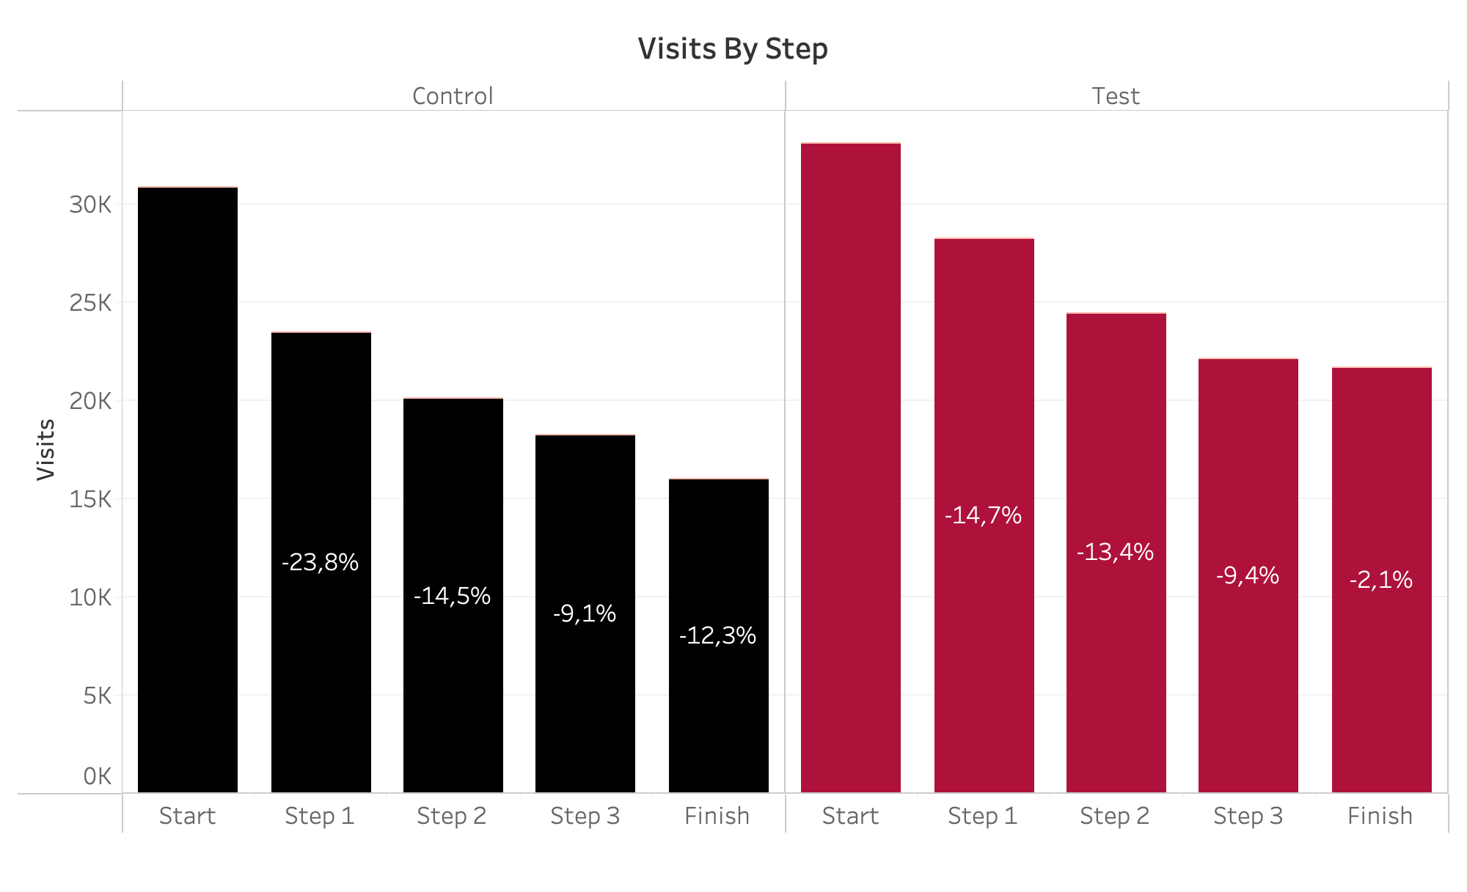
IRONHACK BOOTCAMP DA JAN 31
Which step has the highest drop off?
Notes:
Takeaway - Step 1 & Finish in the control group has the highest drop off

Slide 27
IRONHACK BOOTCAMP DA JAN 31
Conclusions
✅ Implement Changes – +8.7% completion rate surpasses the 5% threshold.
⏳ Focus on Step 0-1 – Most log-in time reductions came from this step.
⚠️ Monitor Error Rates – No major reduction, likely due to a learning curve. A longer test or more training materials may help.
🎯 Key Takeaway – Optimize Step 0-1 for maximum impact with minimal disruption.
Notes:
Go for Implementation – The +8.7% completion rate exceeds the 5% cost-effectiveness threshold. The company should proceed with the web flow improvements.
Key Efficiency Gain – Faster completion time was mainly driven by a significant improvement in Step 0-1.
Error Rate Consideration – No major reduction in errors, likely due to a learning curve. A longer test may help determine if errors stabilize over time.
Final Recommendation – Since Step 0-1 had the biggest impact, most benefits can likely be achieved by optimizing just this step, minimizing disruption while maximizing results.

Slide 28

Elohor, Mike, Prince, Angel

Slide 29
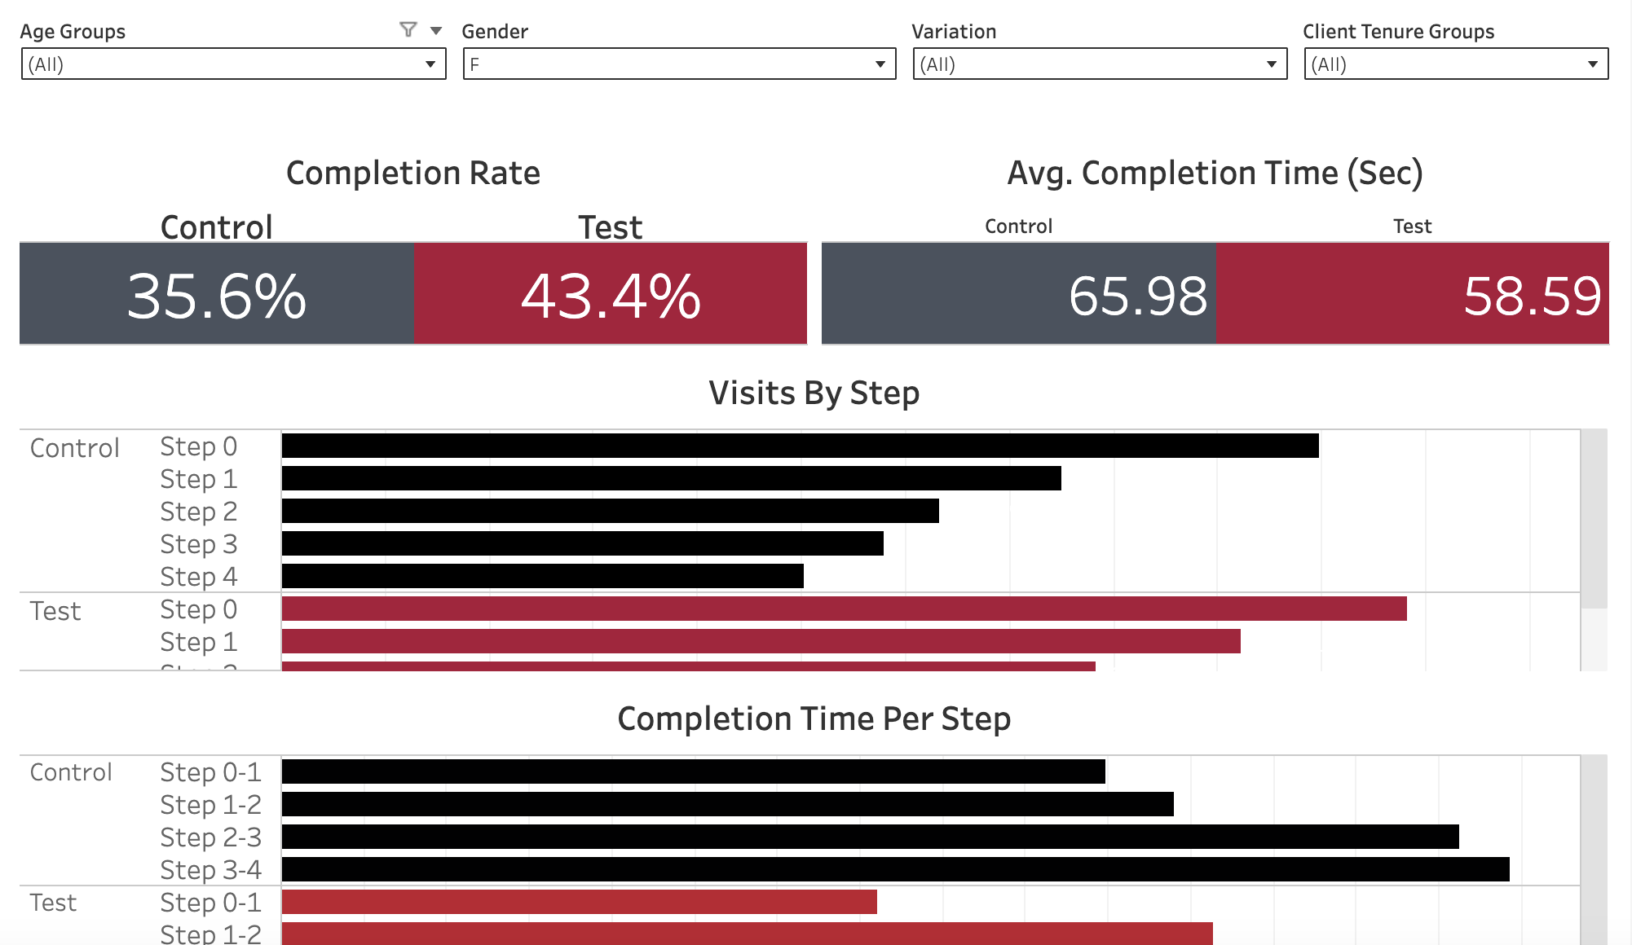
IRONHACK BOOTCAMP DA JAN 31
A/B Test Dashboard

